Slide 1

Data Science Capstone Project
Team: Keras the Python
Obaro Agbanagba
Mustafizur Bhuiyan
Razvan Lungu
Tashlin Reddy
Jun Shao
Presentation 3: Results and Findings
Interventions of Fire Department in Montreal

Slide 2
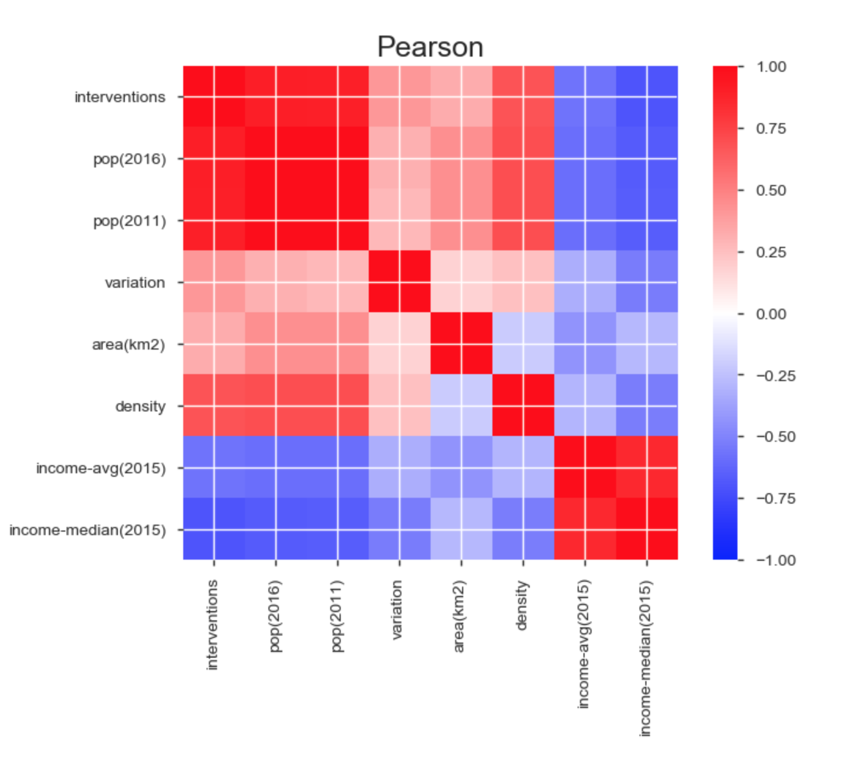
Initial Business Problem and Assumption
The emergency call centre answers various types of incident calls per month, week, day, and hour
Mandate was to analyze correlations between interventions and other merged dataset attributes
End result involved making intervention predictions based on hour of day. So that call centre human resources can properly manage full time and part time employees

Slide 3
External Data Used
The datasets: fire department interventions, barracks, census data from the Ville de Montreal, and Montreal weather datasets were loaded and merged together.
The census data of 2016/2011/2006 included significant information such as language, age group, income bracket, and population per Montreal borough.
The weather data from the Government of Canada web portal involved historic temperature, dew point, and humidity data between 2008 and 2018.
Data cleaning measures were taken to merge, filter unnecessary fields, and assign primary keys

Slide 4
Data Analysis Tools and Pipeline
Alteryx/Python :
Demographic data of 2011 and 2016
By NOM_ARROND
Interventions record
By CASERNE
Fire stations data
Final dataset
Fire stations data
Weather data merging
By Date

Slide 5
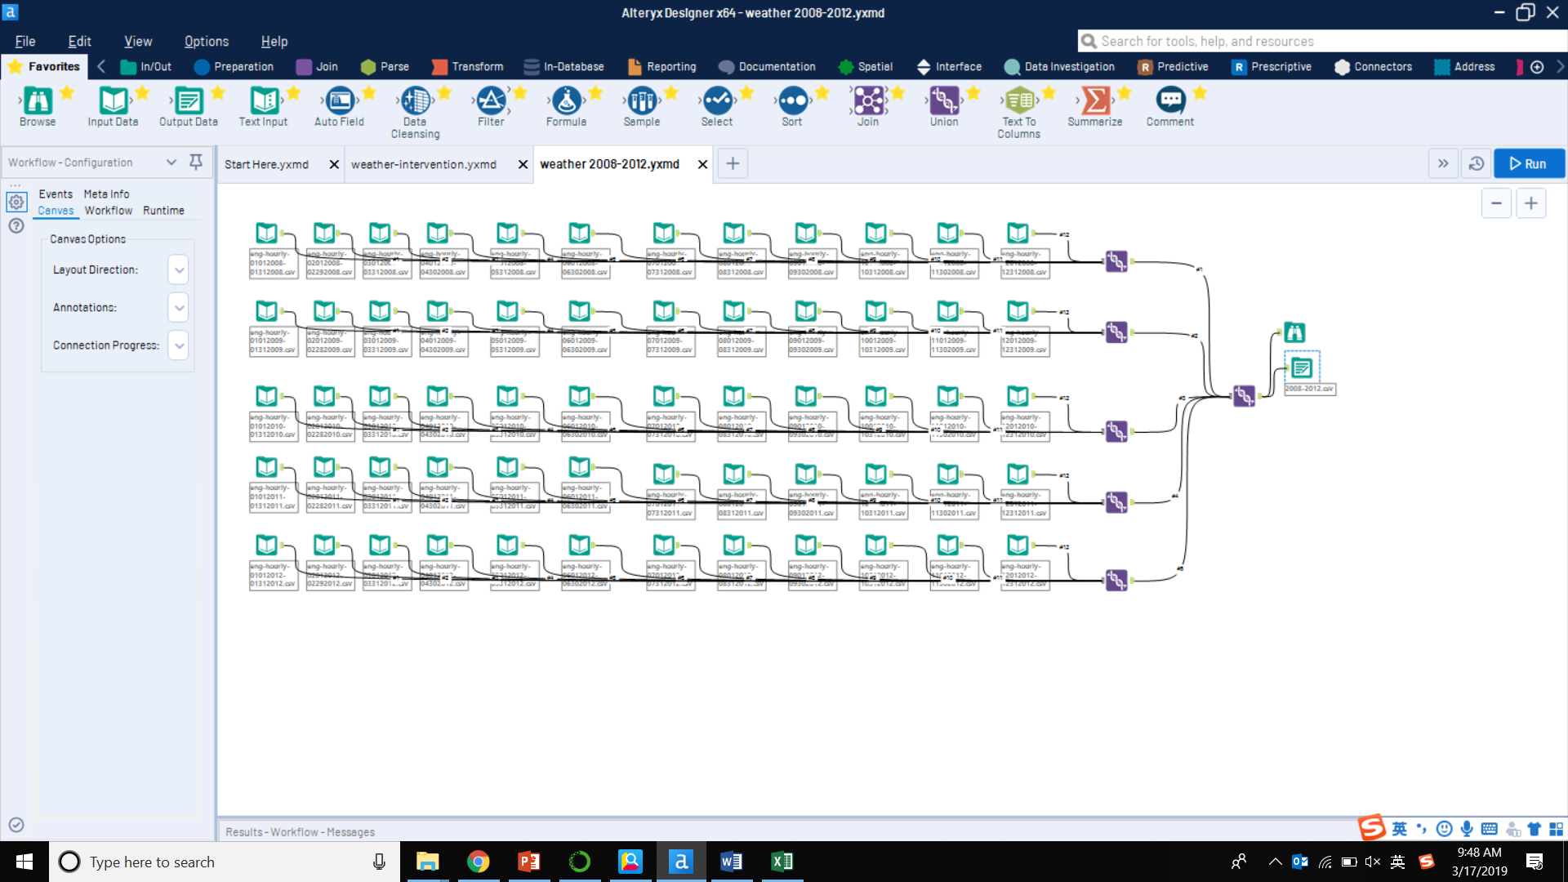
Data Analysis Tools and Pipeline

Slide 6
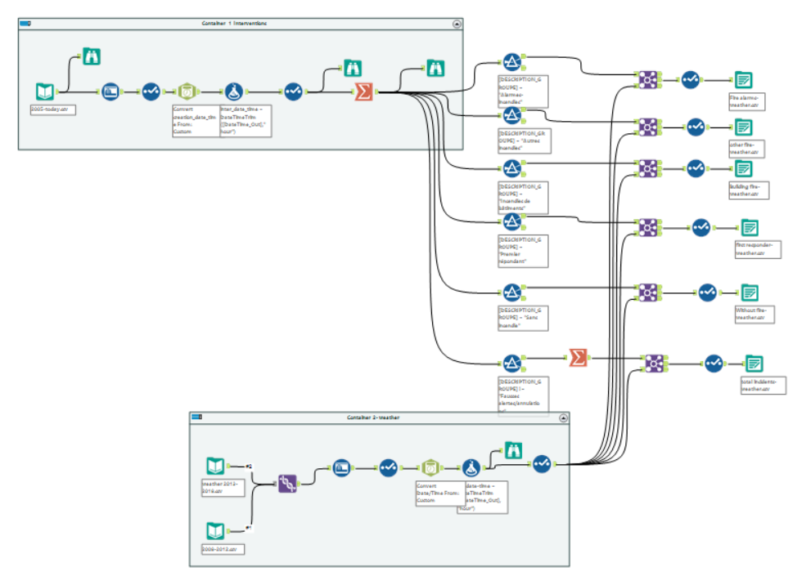
Data Analysis Tools and Pipeline

Slide 7
Models, Predictions, & Results
Linear Regression and MLP were used
LSTM and Keras models were used
FB Prophet model was also experimented with, which is an additive regression model
Comparisons between the three predictors:

Slide 8
Linear Regression and MLP
Linear Regression(hourly)
X features: district(hard-code),hour(code), temperature, dew point, humidity, area, population, density, income(avg) and income(median).
Targets: vehicle units, interventions.
Data split: test_size=0.3
Normalization features: temperature, dew point, humidity, area, population, density, income(avg) and income(median).

Slide 9
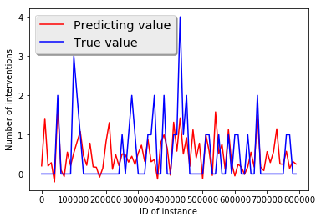
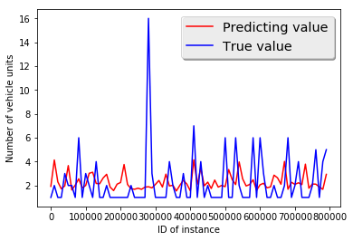
Linear Regression and MLP
Linear Regression ( hourly)
Interventions per hour MSE: 0.0353
Units per hour MSE: 0.2289

Slide 10
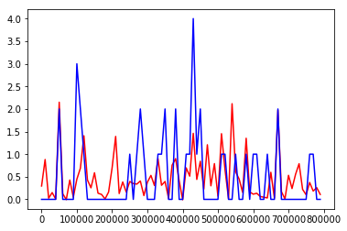
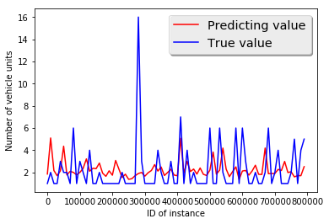
Linear Regression and MLP
Neural Network(hourly)
Data set based on hour as for Linear regression.
Interventions per hour MSE:0.4098
Units per hour MSE: 0.0736

Slide 11
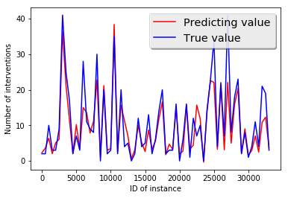
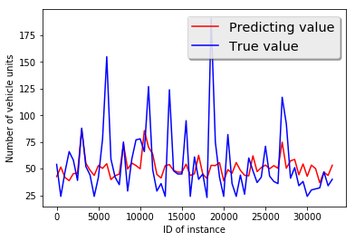
Linear Regression and MLP
Linear Regression ( daily)
Interventions per day MSE:0.111
Units per day MSE: 0.784

Slide 12
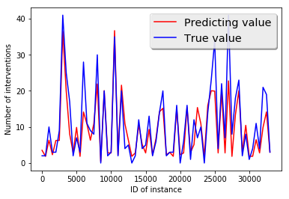
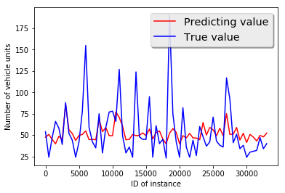
Linear Regression and MLP
Neural Network(daily)
Data set based on day as for Linear regression.
Interventions per hour MSE: 23.236
Units per hour MSE: 394.21

Slide 13
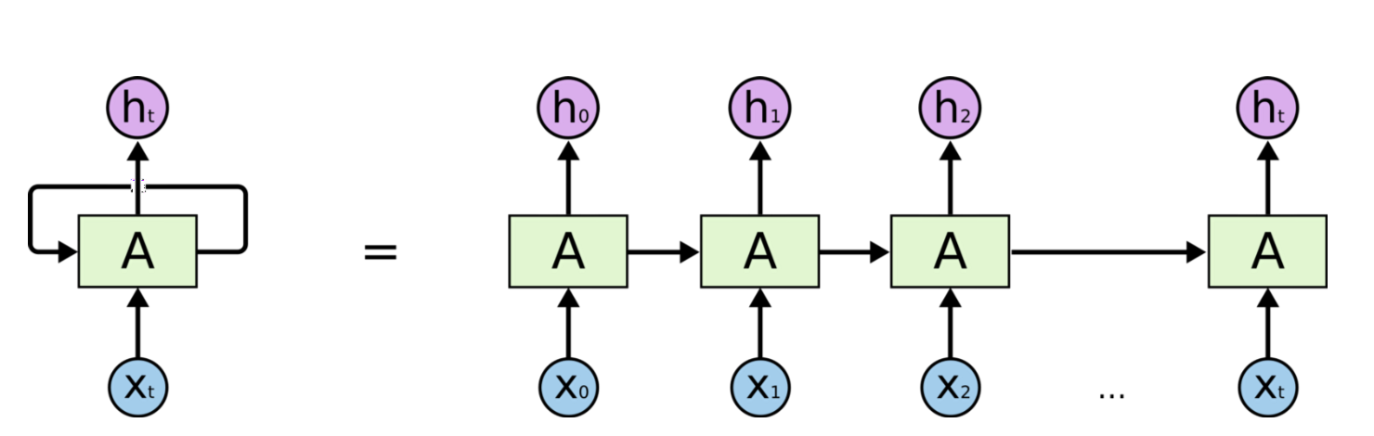
LSTM in Keras
Multivariate time-series forecasting (hourly)
target values (y) = current # of interventions
predictor values (X) = previous hour X values
included weather etc
Normalized using MinMaxScaler
Trained on 6 years of data
cross validated on 2 years
tested on ~2 years

Slide 14
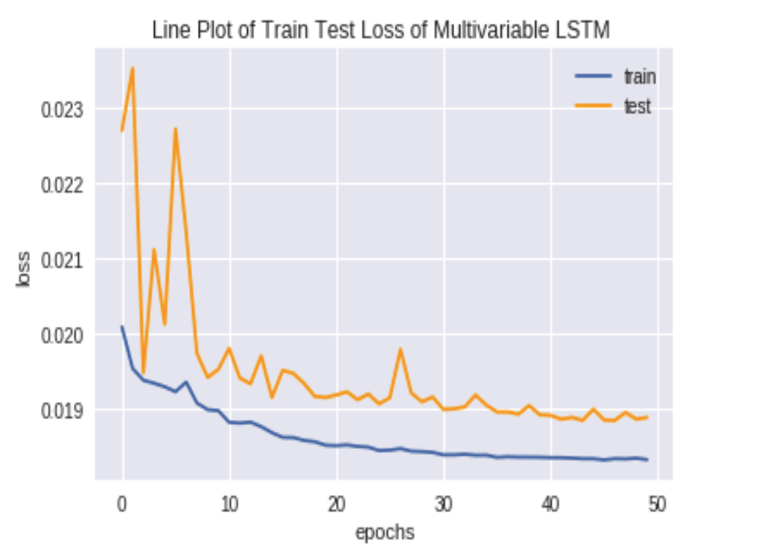
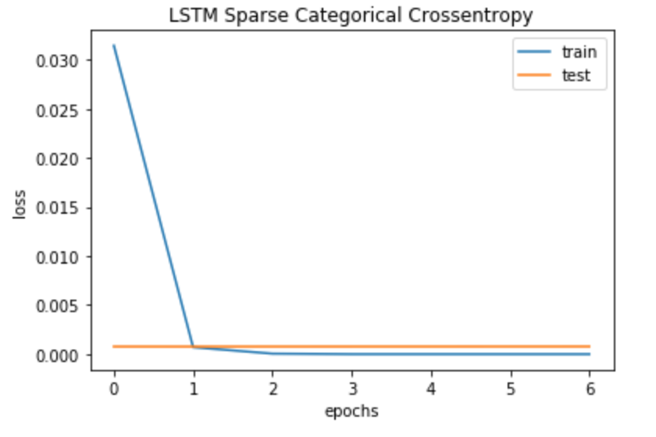
LSTM in Keras

Slide 15
Facebook Prophet
opensource released by Facebook in 2017
procedure for forecasting time series based on an additive model
non-linear trends are fit with yearly, weekly, and daily seasonality,
effects of holidays and changes in trend can be integrated

Slide 16

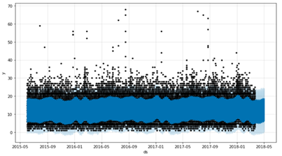
Facebook Prophet

Slide 17
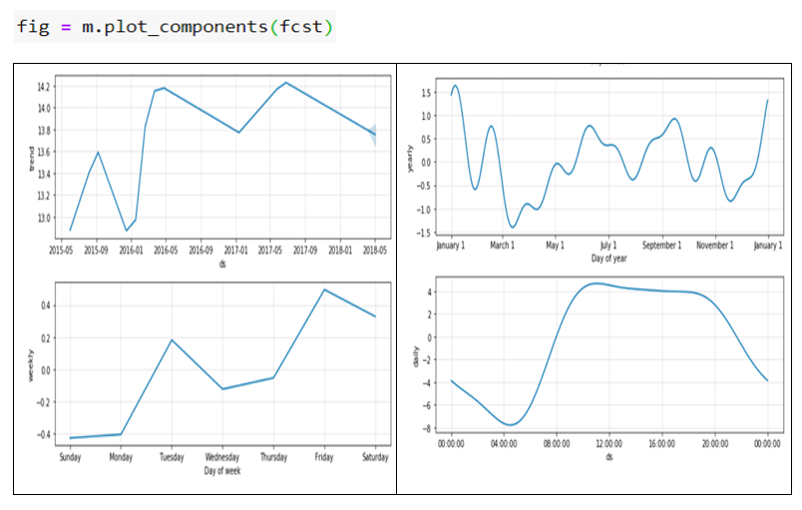
Facebook Prophet

Slide 18
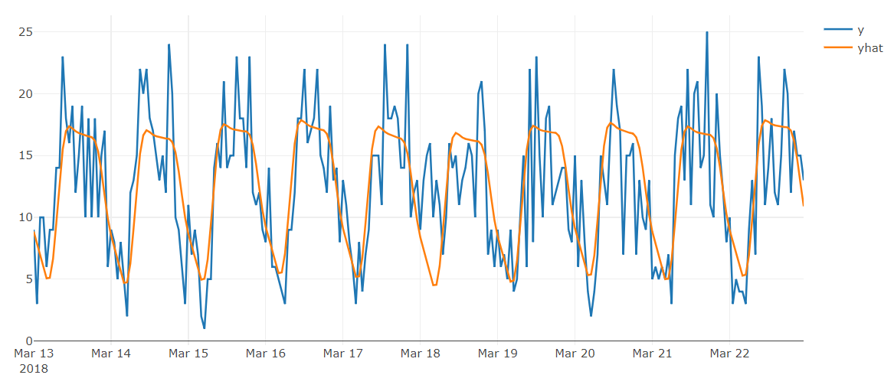
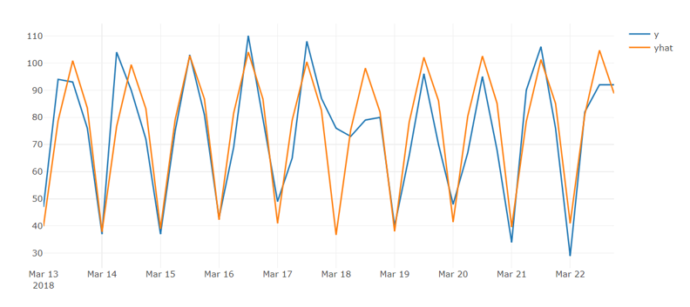
Facebook Prophet
Hourly
6 hour slots
MAPE 13%

Slide 19
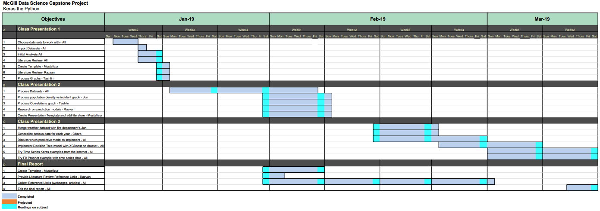
Project Management Tools that were Used
Gantt Chart
Work Breakdown Structure

Slide 20
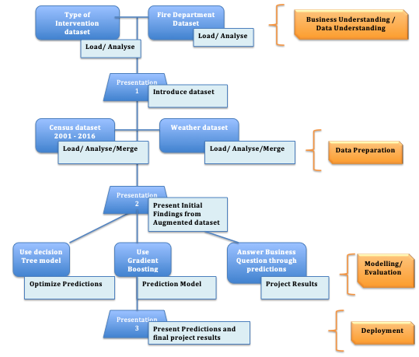
Project Management Tools that were Used

Slide 21
Conclusion
Generally speaking, our goal is to predict the number of incidents that would happen in over the course of a day in a specific location.
In order to do this, we created several models, using multivariate LSTM time series model, Prophet Model, regression and iterative clustering with a neural network predictor.
Although the mse loss is low for linear regression and fully- connected NN model, the overlap between predictive result and true value is not that good. That means features that we chose can’t represent happening of interventions effectively.

Slide 22
Conclusion
Currently, our models only take into account time serials and weather data, with more relative features we believe these models can predict better for interventions happened in a special district per hour and units of vehicles needed per day.
We would like to improve on our current model by augmenting more anthropic and environmental indices such as pollution, topography, type of vegetation etc.
While more advanced models are been developed, time-series–based prediction offers the possibility of improving fire department planning in the near term.

Slide 23
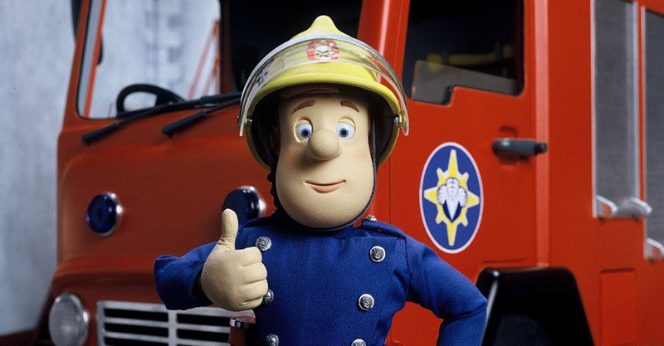
Thank You Questions?

